Slide 1

UAV with integrated Observation System for Artillery Fire Guidance

Slide 2
Group Members
IDP group 09
201814104 Lt Mushfiqur Rahman
17021437 Lt Tamzid Hasan Limon
201914045 Md Samir Hasan
201914044 Abdullah Al Masum
201914029 Md Wasif-ul-Islam
201914024 Shad Reza

Slide 3
Objective
To study the feasibility of UAV based artillery fire guidance system.
To introduce automated fire guidance system.
To evaluate the developed system.

Slide 4
Outcomes
An autonomous artillery fire guidance system.
Infusion of cutting edge technology for the first time in Corps of Artillery.
Ensuring training safety by replacing military personnel with technology in dangerous search and defuse operation.

Slide 5
State of Art
In present, an officer called ‘Observer’ is employed to guide artillery firing
He assumes a higher vantage point to observe the area of impact.
Upon impact he estimates approximate error and sends the data to the gun position for correction.
In case, any shell becomes blind, he tries to estimate its impact point and sends the data back to gun position for search and defuse operation.

Slide 6
Shell Firing
Simulation

Slide 7
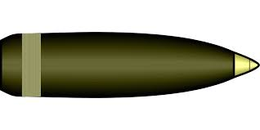
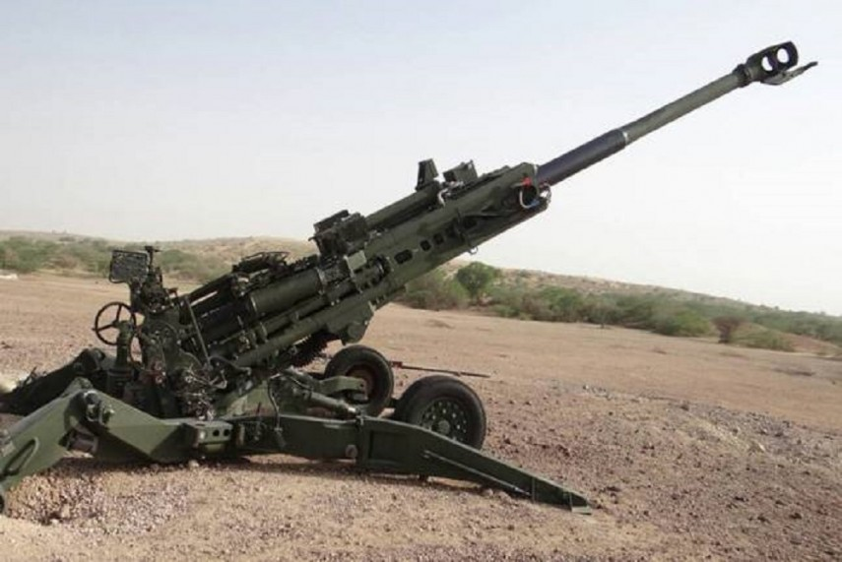

RADIUS 300-400 m
TARGET OBJECT
DISTANCE
16/35/50 KM

Slide 8
Limitations of the existing system
Since the error margin of artillery firing is estimated by a static observer therefore naturally the result is grossly inaccurate.
Real time fire guidance is not possible as the observer manually sends the correction data.
In present, it takes a considerable amount of time to guide artillery firing.
For blind shell, search and defuse operation is life risking.

Slide 9
Proposed Work Features
Automated Artillery Fire Guidance.
Real time fire correction.
Accurate impact point detection using GPS.
Risk-free and quick blind shell detection

Slide 10
Intended Users
End Users:
Corps of Artillery

Slide 11
System Architecture
Application Based Interface
Drone
Drone Control Module
Configurational Services
Drone Management
GPS Module Management
Utility Services
Operating System
System Server
Application Services
Shell Detection
GPS Tracking
Altitude & Angle Calculation

Slide 12
Functional Requirements
To get the exact GPS location where the sell impacted
To reduce the whole processing time of target Acquisition and increase the Precision
To significantly reduce the degree of error of determining the exact hit point
To evaluate & locate the pin-point of every fired mortar shell including (burst and blind shell) in real time
Ensuring training safety by replacing military personnel with technology in dangerous search and defuse operation.

Slide 13
Non-functional Requirements
User-friendly System ( Easy to use and also easy to operate )
Real Time Feedback ( by using ad hoc network system )
To provide security monitoring of the impact area or region and provide tracking aid to serve as eyes for any surveillance team in bombing place.

Slide 14
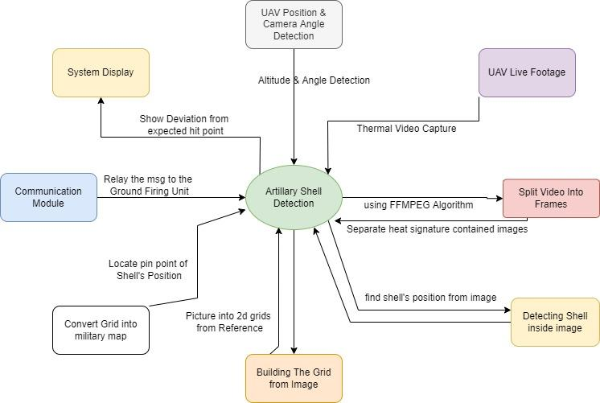
Context Diagram

Slide 15
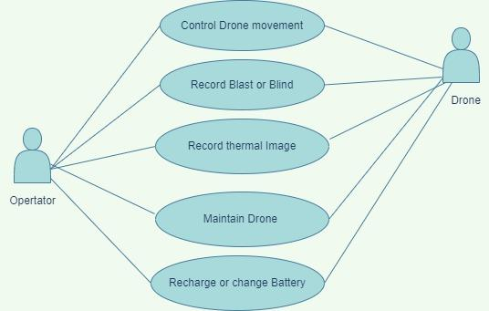
Use case Diagram for Drone Operator

Slide 16
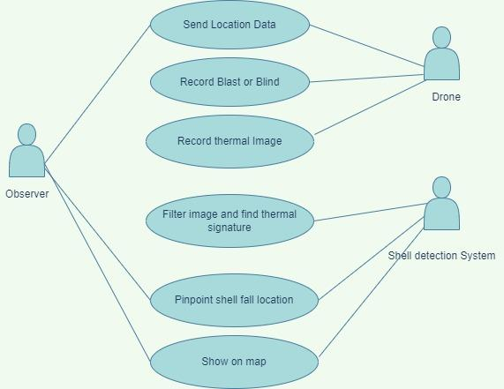
Use case Diagram for Observer

Slide 17
Limitations
If UAV is used, then Additional Backup Power Supply Needed For Longer Stand-by
If UAV is used, then The Stabilization System Must Be Very Accurate
If we go for static, then multiple (at least 3) Thermal camera required to cover the training region.
To afford a better quality artillery fire guidance system which fulfills our requirements, either Drone or High Speed Thermal Camera, our budget is the biggest limitation.

Slide 18
Future Work
At the first phase, we will try to establish a static system using thermal cameras where communication medium is wired.
So, the next phase of our work will be wireless communication system with autonomous drone
And Our third phase of work will be eliminating GPS from this military context, we will try to establish our own tracking module using our own satellite & military map.

Slide 19
Stalker App Demonstration

Slide 20
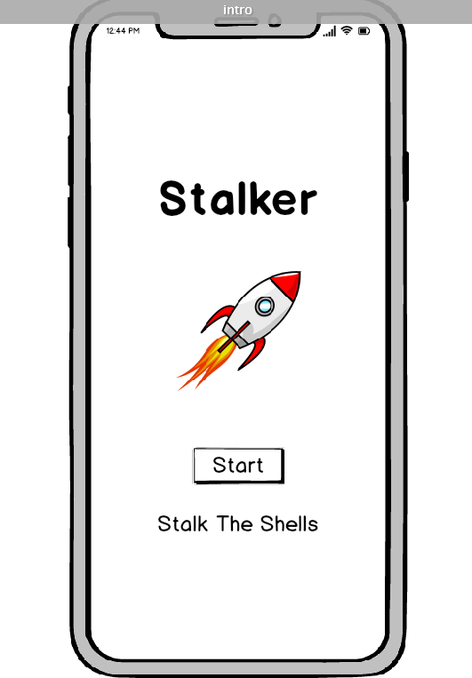

Slide 21
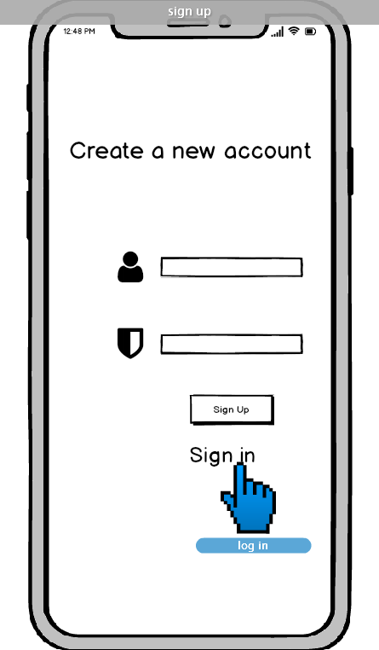

Slide 22
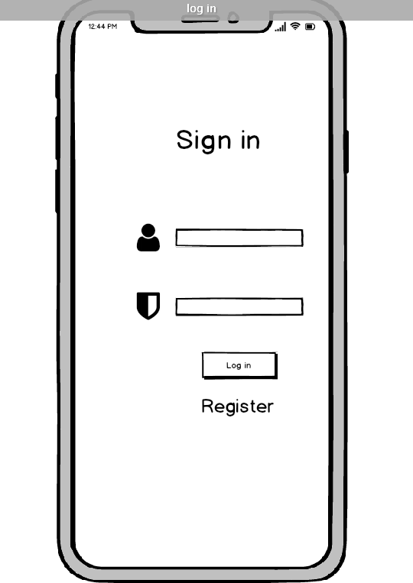

Slide 23
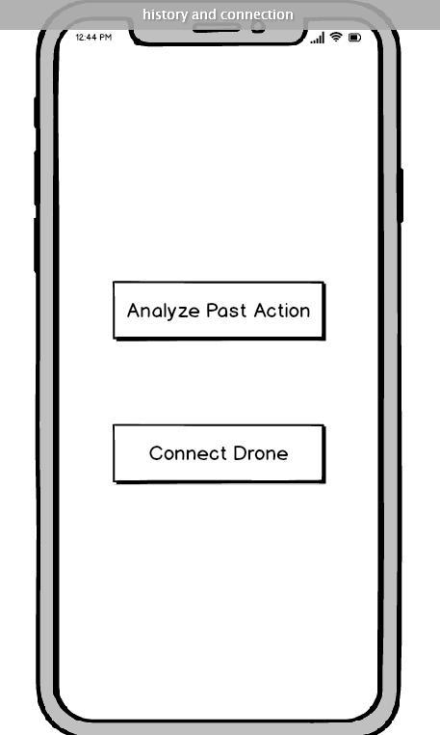

Slide 24
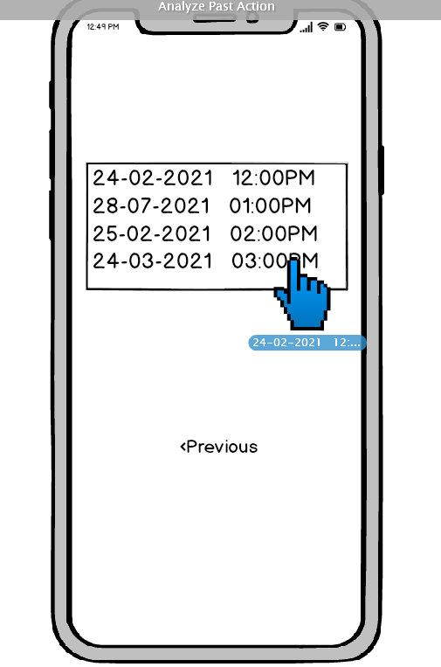

Slide 25
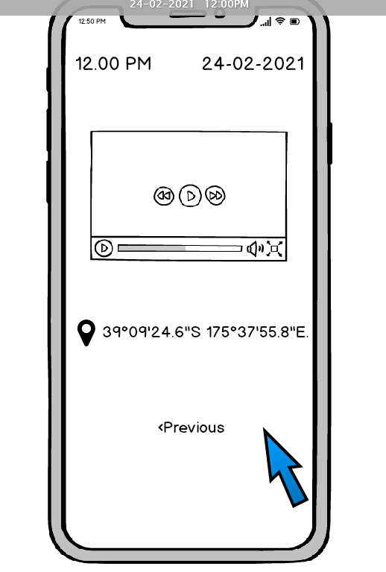

Slide 26
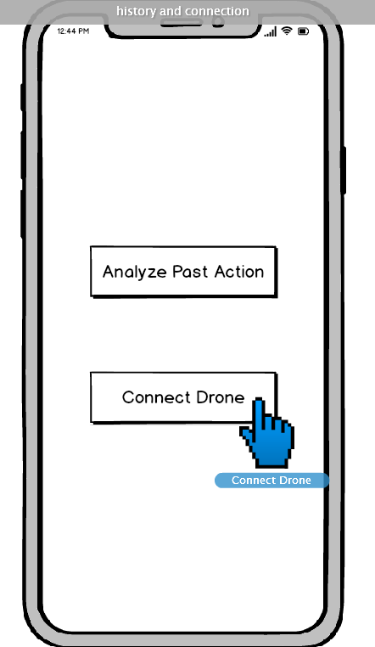

Slide 27
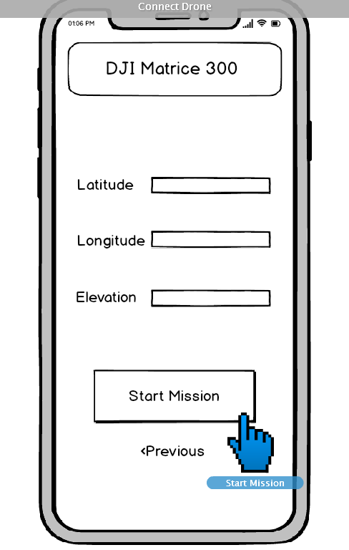

Slide 28
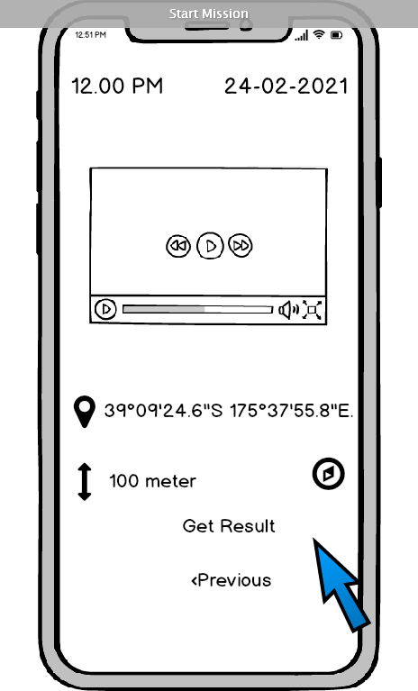

Slide 29
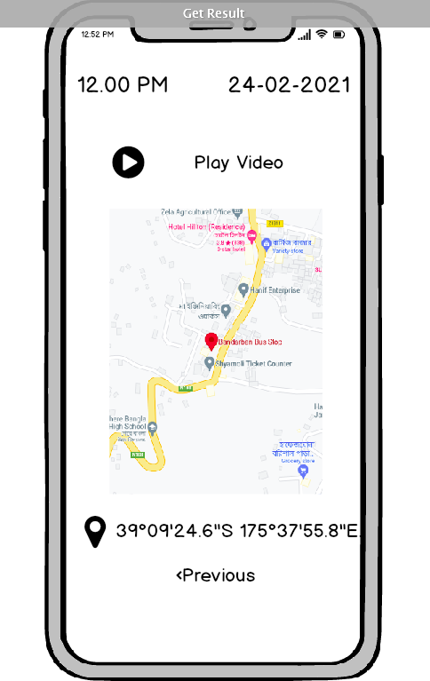

Slide 30
Thanks!

